Slide 1
Test Study Guide/Breakdown
Geometry Unit 3: Proofs

Slide 2
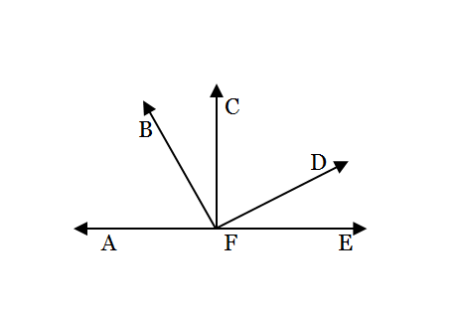
Identify the Property, Postulate, Theorem…With a diagram - 2 Problems
You will be given a statements, along with a diagram. You must Identify which postulate, property, definition, or theorem is being demonstrated in the statement.
Examples:
1.) $AF+FE=AE$
Segment Addition Postulate
4.) If $F$ is the midpoint of $\overline{AE}$, then $AF=1/2AE$
Midpoint Theorem

Slide 3
Identify the Property, Postulate, Theorem… - 10 Problems
You will be given a statements. You must Identify which postulate, property, definition, or theorem is being demonstrated in the statement.
Examples:
7.) If $m<A+ m<B=180°$ and $m<C+m<D=180°$, then $m<A+m<B=m<C+m<D$
10.) If $MQ=MP+PQ$ and $MP+PQ=RS$, then $MQ=RS.$
Substitution Property
Substitution/Transitive Property

Slide 4
Using Theorems – 4 problems
You will be given an incomplete statement of a theorem. You will need to complete the statement.
Example:
14.) Angle Bisector Theorem: If $\vec{BD}$ bisects $<ABC$, then…
17.) Theorem 2-5: If two lines form congruent adjacent angles, then…
$m<ABD=1/2ABC$ and $m<DBC=1/2ABC$
The lines are perpendicular

Slide 5
Using Definitions – 4 problems
You will be given an incomplete definition. You will need to complete the definition.
Examples:
11.) Definition of midpoint: If $M$ is the midpoint of $\overline{AB}$, then…
18.) Definition of Perpendicular Lines: Two perpendicular lines intersect…
$$AM=MB$$
To form right angles ($90°$)

Slide 6
Proofs – 5 Total
You will be given 2 proofs with all of the statements filled in, and you must give the reasons. 2 more proofs will have the reasons filled in, and you must give the statements. And 1 final proof where you must fill in the blank, with a mix of blank statements and reasons.

Slide 7
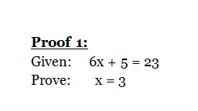
Proofs – Example 1
1.) $6x+5=23$
1.) Given
2.) $6x=18$
2.) Subtraction Property
3.) $x=3$
3.) Division Property

Slide 8
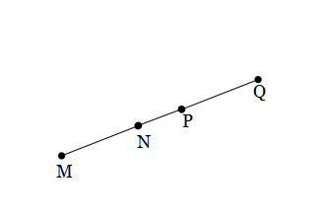
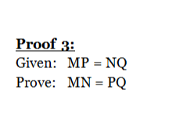
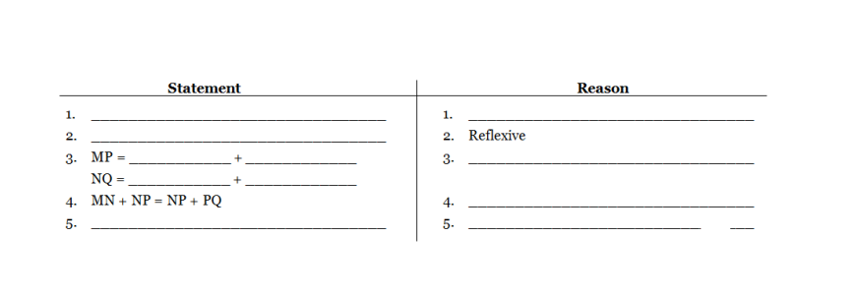
Proofs – Example 2
$$MP=NQ$$
Given
$NP=NP$
$$MN$$
$$NP$$
Segment Addition Postulate
$$NP$$
$$PQ$$
Substitution Property
$MN=PQ$
Subtraction Property

Slide 9
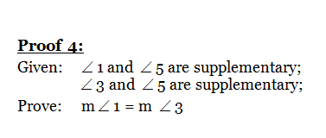
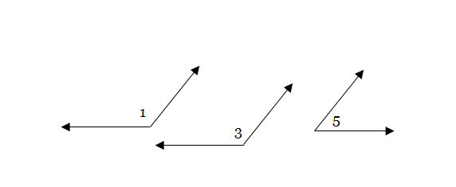
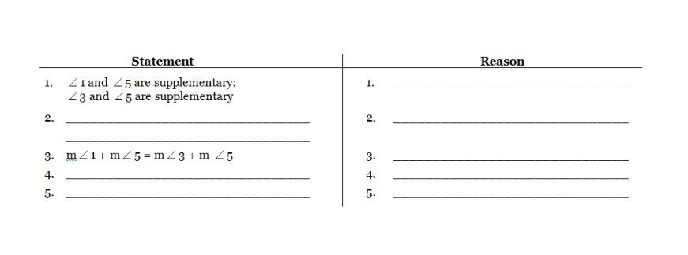
Proofs – Example 3
Given
$m<1+m<5=180°$
Def. of Supplementary <‘s
$m<3+m<5=180°$
Substitution Property
$$m<5=m<5$$
Reflexive Property
$m<1=m<3$
Subtraction Property

