Slide 1
Geometry Unit 4
Test Review/Breakdown

Slide 2
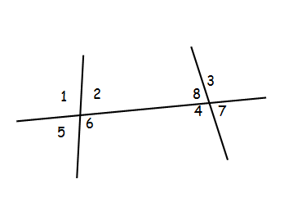
Identify Special Angle Pairs – 4 Questions
Use a diagram to name a pair for the given description
1. Same-side interior angles.
2. Alternate interior angles.
3. Corresponding angles.
4. Alternate exterior angles.
< 2 and < 8
< 6 and < 8
< 6 and < 7
< 3 and < 5

Slide 3
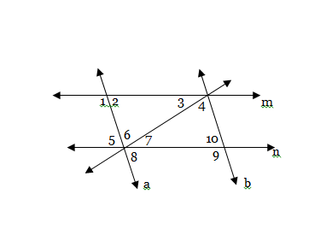
Using Information and a Diagram to find missing angle measures – 4 Questions
5.) If $m<6=85°$, find $m<4.$
$$m<4=85°$$
6.) If $m<1=127°$, find $m<10.$
$$m<10=53°$$

Slide 4
Using the same Diagram make and solve equations – 2 Questions
5.) $m<2=7x−3$, $m<5=6x+8$
Eq: $7x−3=6x+8$ (Why?)
$$x=11$$
6.) If $m<4=11x−2$, $m<7=14x+7$
Eq: $11x−2+14x+7=180$ (Why?)
$$25x+5=180$$
$$25x=175$$
$$x=7$$

Slide 5
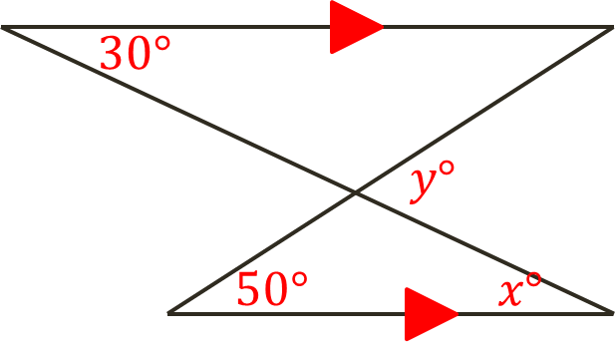
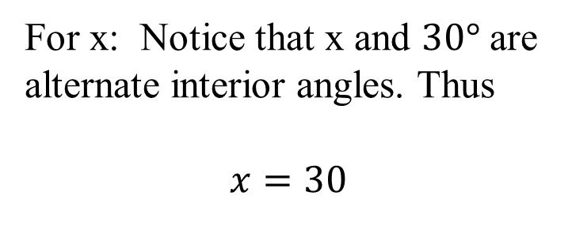
Given Parallel Lines, solve for missing variables – 5 Questions
For x: Notice that x and $30°$ are alternate interior angles. Thus
$x=30$
For y: y is and exterior angle of the top interior angle from the bottom triangle. So by theorem 3-12 we can write
$$50+x=y$$
$$50+30=y$$
$$y=80$$

Slide 6
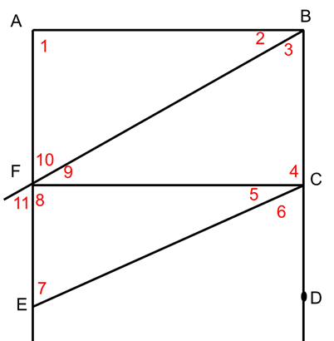
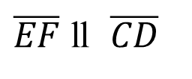
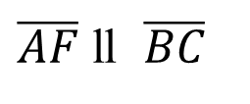
Parallel Lines Worksheet
Use the given information to name a pair of segments that must be parallel. If no such segments exist, write none.
Hint: Use the Angles given in the problem. If they correctly make one of the special pairs we talked about in class (Alt. Int. <’s, Alt. Ext. <’s, S-S Int. <’s, or Corr. <’s) then you do have parallel segments.
1. $m<2+m<10=180$
$\overline{AF}$ ll $\overline{BC}$
2. $m<1=m<4=90$
None
3. $<6 ≅ <7$
$\overline{EF}$ ll $\overline{CD}$

Slide 7
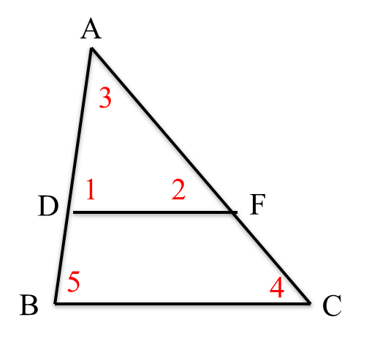
Proofs – 2 Questions
You will have two proofs to fill in. You will have some statements and reasons filled in, then you fill in the rest.
Given: $\overline{DF}$ ll $\overline{BC}$
Prove: $m<3+m<4+m<5=180$
Statements ________ _______Reasons
$m<3+m<1+m<2=180$
1. <‘s of a Triangle add to 180
2. $\overline{DF}$ ll $\overline{BC}$
2. Given
3. $<1≅ <5 or m<1=m<5;$
$$<2≅ <4 or m<2=m<4$$
3. w/parallel lines, corr. <‘s are $≅$
4. $m<3+m<4+m<5=180$
4. Substitution Property

