Slide 1
Geometry Unit 7
Test study Guide/Breakdown

Slide 2
Word Problems with Ratios – 1 Problem
Example:
The measures of the angles of a triangle are in the ratio 3:4:5. Find the measure of all the angles.
Solution:
Make an equation using the ratios and how they relate to the term described
$3x+4x+5x=180$
Next solve the equation for x:
$$12x=180$$
$$x=15$$
Then multiply the value of x into the three numbers in the ratio to find the angles
$3\left(15\right)=45$ $4\left(15\right)=60$ $5\left(15\right)=75$

Slide 3
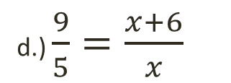
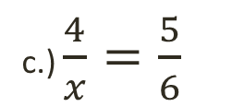


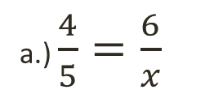

Identify the Correct Proportions – 1 Question
Example: Identify (circle) all proportions that can be used to solve for the given variable.
a.) $\frac{4}{5}=\frac{6}{x}$
b.) $\frac{4}{6}=\frac{5}{x}$
c.) $\frac{4}{x}=\frac{5}{6}$
d.) $\frac{9}{5}=\frac{x+6}{x}$
e.) $\frac{4}{9}=\frac{x+6}{6}$
f.) $\frac{9}{4}=\frac{x+6}{6}$

Slide 4
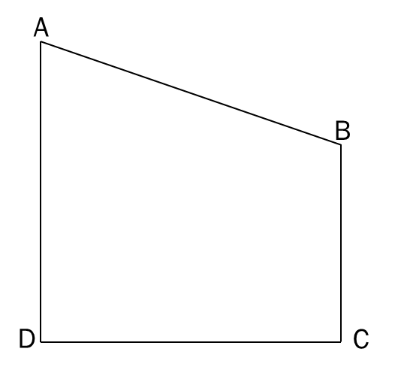
Solving for missing sides and angles in similar polygons.
$ABCD\sim A^{′}B^{′}C^{′}D′$. Determine the following values based on the given diagrams.
A.) scale factor of ABCD to A’B’C’D’ B.) $m<B$
C.) $m<C$ D.) $D^{′}C′$ E.) $AB$
A’
32
$$66°$$
B’
15
$$118°$$
24
12
D’
C’

Slide 5
Solving for missing sides and angles in similar polygons.
Solutions:
A.) scale factor of ABCD to A’B’C’D’
Use the corresponding sides that both have measures given:
$$\frac{AD}{A^{′}D′}=\frac{15}{24}=\frac{5}{8}$$
A’
32
$$66°$$
B’
$$118°$$
15
24
12
D’
C’

Slide 6
Solving for missing sides and angles in similar polygons.
Solution:
B.) $m<B$
Corresponding Angles are Congruent
Since $m<B^{′}=118$, then $m<B=118$.
C.) $m<C$
Now that we have 3 of the 4 angles in Quad ABCD, we can find $m<C$
$$m<A+m<D+m<B+m<C=360$$
$$66+90+118+m<C=360$$
$$274+m<C=360$$
$$m<C=86$$
A’
32
B’
$$66°$$
$$118°$$
24
15
12
D’
C’

Slide 7
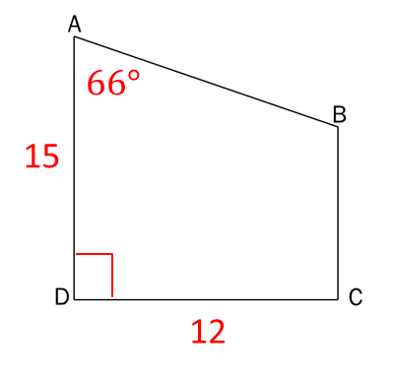
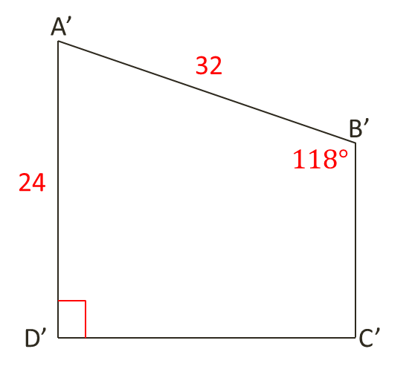
Solving for missing sides and angles in similar polygons.
D.) $D^{′}C′$
Make a proportion with this side and its corresponding side, set equal to the scale factor:
$\frac{DC}{D^{′}C^{′}}=\frac{12}{x}=\frac{5}{8}$
$$96=5x$$
$$x=\frac{96}{5} or 19\frac{1}{5}$$
E.) $AB$
Do the same that you did for part D.):
$$\frac{AB}{A^{′}B′}=\frac{x}{32}=\frac{5}{8}$$
$$8x=160$$
$$x=20$$

Slide 8
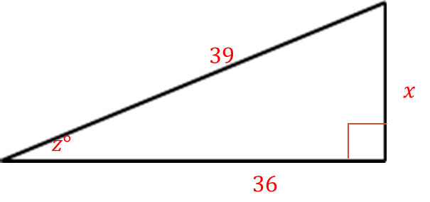
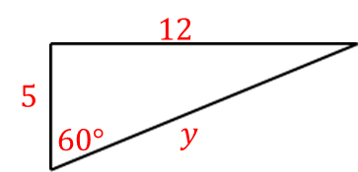

Solving for missing sides and angles in similar polygons
Given similar polygons, find the values of x, y and z.
To Find x and y, we first need the scale factor between the two triangles.
Using the pair of known corresponding sides, we get
Scale Factor:
$$\frac{12}{36}=\frac{1}{3}$$

Slide 9



Similar Polygon examples
Two similar polygons are shown. Find the values of x, y, and z.
$$12$$
$$60°$$
$$39$$
$$5$$
$$x$$
$$60°$$
$$y$$
$$z°$$
$$36$$
Using this scale factor, we can make proportions to solve for x and y.
To Find z, first match the corresponding angles.
For x:
$$\frac{1}{3}=\frac{5}{x}$$
$$x=15$$
For y:
$$\frac{1}{3}=\frac{y}{39}$$
$$3y=39$$
$$y=13$$
For z:
$$z+60+90=180$$
$$z+150=180$$
$$z=30$$

Slide 10
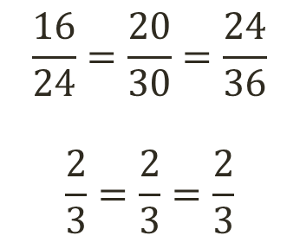
Practice using the Postulates and Theorems – 2 Questions
Can the two triangles given be proven similar? If so, state the similarity and tell which similarity postulate or theorem you would use. Be sure you can explain when it does work, as well as when it doesn’t.
These triangles are congruent by the _____ _________ ________ because
Use proportions with the sets of corresponding sides. The goal is to simplify them so that they end up equal. If they do, then the triangles are similar.
20
24
30
$$\frac{16}{24}=\frac{20}{30}=\frac{24}{36}$$
$$\frac{2}{3}=\frac{2}{3}=\frac{2}{3}$$
16
36
SSS
Similarity
Theorem
The sides of the triangles are in proportion.

Slide 11
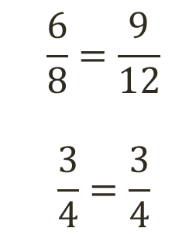
Practice using the Postulates and Theorems – 2 More Questions
Can the two triangles given be proven similar? If so, state the similarity and tell which similarity postulate or theorem you would use. Be sure you can explain when it does work, as well as when it doesn’t.
The triangles are NOT similar because
$$\frac{6}{8}=\frac{9}{12}$$
$$\frac{3}{4}=\frac{3}{4}$$
12
6
8
9
But be sure they work for SSS, SAS, or AA. The sides are proportional, but they do not fall between the congruent angles
The proportional sides are not between the congruent angles.

Slide 12
Proportional Lengths – 2 Questions
Make a proportion and solve for the value of x
Solution:
$$\frac{2x−5}{21}=\frac{10}{14}$$
$$\frac{2x−5}{21}=\frac{5}{7}$$
$$14x−35=105$$
$$14x=140$$
$$x=10$$

Slide 13
Proportional Lengths – 2 Questions
Make a proportion and solve for the value of x
Solution:
$$\frac{3x−5}{10}=\frac{20}{8}$$
$$\frac{3x−5}{10}=\frac{5}{2}$$
$$6x−10=50$$
$$6x=60$$
$$x=10$$

Slide 14
Proportional Lengths – 2 Questions
Make a proportion and solve for the value of x
$$\frac{7+14x}{22}=\frac{35}{10}$$
$$\frac{7+14x}{22}=\frac{7}{2}$$
$$14+28x=154$$
$$28x=140$$
$$x=5$$

Slide 15
Real World Example – 2 Questions
You will be given problems where you must enlarge an object using ratios. You will have to select the right size from a list of options given to you.
The key to choosing the right answer is by using proportions!
Make sure you can explain your choice as well.

