Slide 1
Geometry Unit 5
Using Congruent Triangles

Slide 2
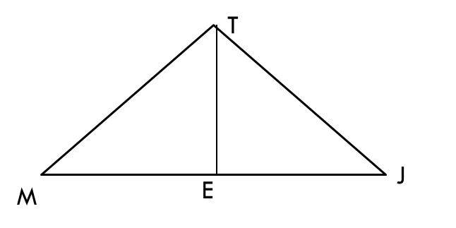
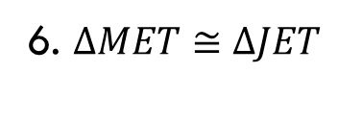
Using the Postulates
Supply the missing statements and reasons in the following proof.
Given: $E$ is the midpoint of $\overline{MJ}$
$\overline{TE} \overline{MJ}$
Prove: $∆MET≅∆JET$
Statements ________ _______Reasons
$E$ is the midpoint of $\overline{MJ}$
1. Given
2. $\overline{ME}≅\overline{EJ}$
2. Def. of Midpoint
3. $\overline{TE} \overline{MJ}$
3. Given
4. $<MET≅ <JET$
4. Def. of Perp. Lines
5. $\overline{TE} ≅\overline{TE}$
5. Reflexive
6. $∆MET≅∆JET$
6. SAS Postulate

Slide 3
Using Congruent Triangles
Content Objective: Students will be able to use congruent triangles to prove that their corresponding parts are congruent.
Language Objective: Students will be able to write up a plan for proving that corresponding parts of congruent triangles are congruent.

Slide 4
Using Congruent Triangles
Our goal from the last section was to prove that two triangles are congruent.
Our goal in this section is to deduce information about segments or angles once we have shown that they are corresponding parts of congruent triangles.

Slide 5
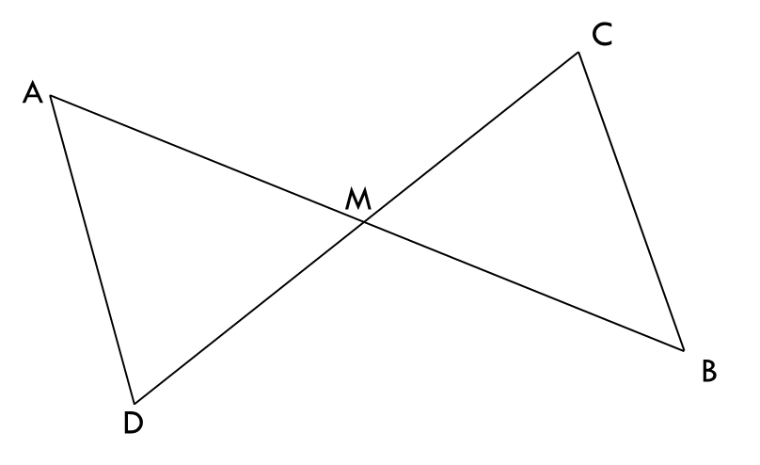
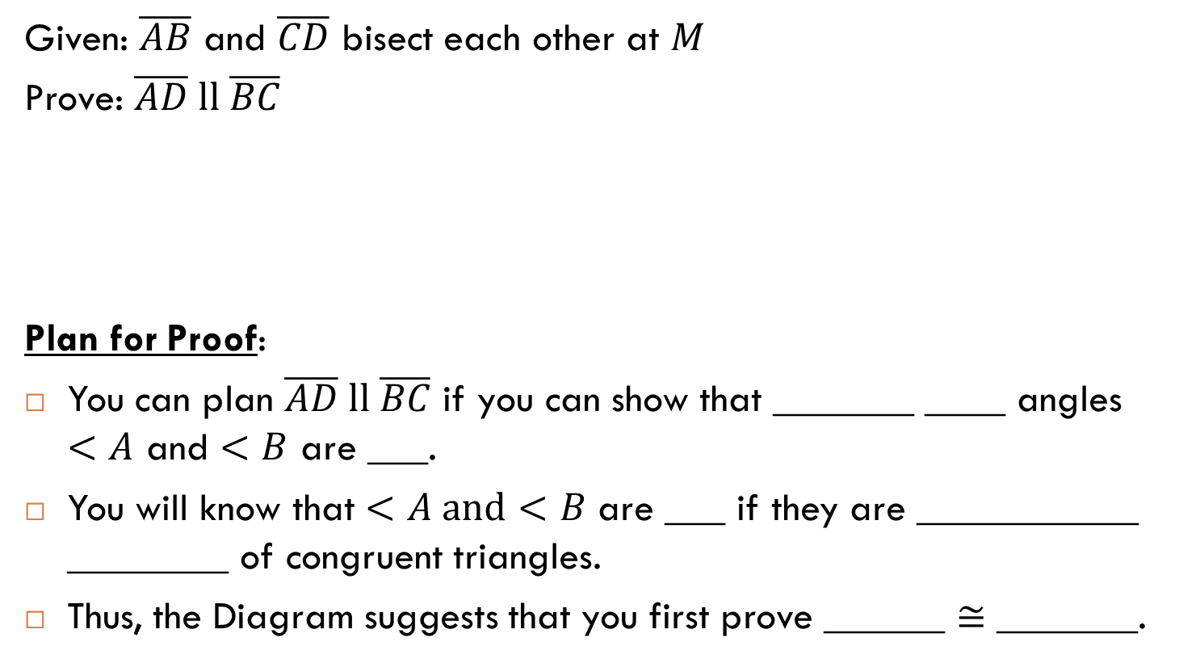
Example : Complete this Proof
Given: $\overline{AB}$ and $\overline{CD}$ bisect each other at $M$
Prove: $\overline{AD} ll \overline{BC}$
Plan for Proof:
You can plan $\overline{AD} ll \overline{BC}$ if you can show that _______ ____ angles $<A$ and $<B$ are ___.
You will know that $<A and<B$ are ___ if they are ___________ ________ of congruent triangles.
Thus, the Diagram suggests that you first prove ______ $≅$ _______.
Alt.
Int.
$$≅$$
$$≅$$
Corresponding
Parts
$$∆ADM$$
$$∆BCM$$

Slide 6
Example : Complete this Proof
Now, on to the proof:
Statements ________ _______ Reasons
1. $\overline{AB}$ and $\overline{CD}$ bisect each other at $M$
1. Given
2. $M is the midpoint of \overline{AB}$ and $\overline{CD}$
2. Def. of a Segment Bisector
3. $\overline{AM}≅\overline{MB}$ ; $\overline{DM} ≅ \overline{MC}$
3. Def. of Midpoint
4. $<AMD≅ <BMC$
4. Vertical <‘s are $≅$
5. SAS Postulate
5. $∆AMD≅∆BMC$
6. $<A≅ <B$
6. CPCTC
7. If 2 lines ACBAT and Alt. Int. <‘s are $≅$, then the lines are ll.
7. $\overline{AD} ll \overline{BC}$

Slide 7
Coming Up with a Plan
When trying to prove if two segments or two angles are congruent, follow this strategy.
1.) Identify two triangles in which the two segments or angles are corresponding parts.
2.) Prove that those triangles are congruent.
3.) State the two congruent parts, using the reason
*Extra planning may be needed if you need to prove more things (i.e. lines are parallel, lines are perp., etc.)
$$CPCTC$$

Slide 8
Coming up with a Plan: Example A
Describe the plan for proving the following
Given: $\overset{⃡}{PR}$ bisects $<QPS;$ $\overline{PQ}≅\overline{PS}$
Prove: $<Q≅<S$
Q
1.) $<Q$ is in ; $<S$ is in
$$∆PSR$$
$$∆PQR$$
P
R
2.) Prove that $∆PQR ≅ ∆PSR$
3.) State that $<Q≅ <S$ by
$$CPCTC$$
S

Slide 9
Coming up with a Plan: Example B
Describe the plan for proving the following
Given:$\overline{WX}≅\overline{YZ};$ $\overline{ZW}≅\overline{XY}$
Prove:$\overline{WX} ll \overline{ZY}$
Z
Y
3
2
1.) $\overline{WX}$ is in ; $\overline{YZ}$is in
$$∆ZYX$$
$$∆XWZ$$
4
2.) Prove that $∆XWZ ≅ ∆ZYX$
1
W
X
3.) State that $<1≅ <2$ or $<3≅ <4$ by
$$CPCTC$$
4.) State that $\overline{WX} ll \overline{ZY}$ because we have
$$Alt. Int. <^{′}s ≅$$

Slide 10
Coming up with a Plan: Example C
Describe the plan for proving the following
Given:$\overline{CD} \overline{AB};$
$D$ is the midpoint of $\overline{AB}$
Prove: $\overline{CA}≅\overline{CB}$
A
D
B
1.) $\overline{CA}$ is in ; $\overline{CB}$is in
$$∆CAD$$
$$∆CBD$$
2.) Prove that $∆CAD ≅ ∆CBD$
C
3.) State that $\overline{CA}≅\overline{CB}$ by
$$CPCTC$$

Slide 11
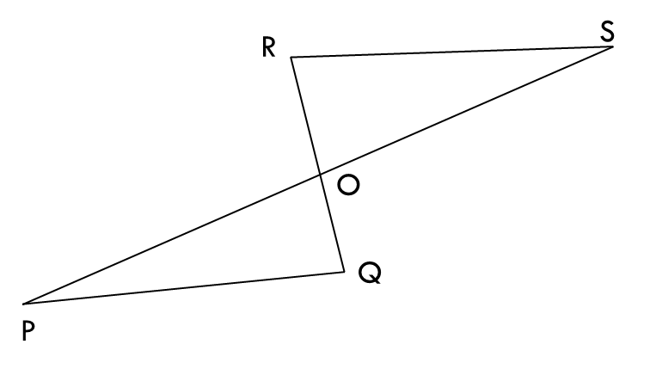
Exit Ticket: Complete the Proof
Given: $<P≅ <S$
$O$ is the midpoint of $\overline{PS}$
Prove: $O$ is the midpoint of $\overline{RQ}$
Statements ________ _______ Reasons
1. $<P≅ <S$
1. Given
2. $O is the midpoint of \overline{PS}$
2. Given
3. $\overline{PO}≅\overline{OS}$
3. Def. of Midpoint
4. $<POQ≅ <SQR$
4. Vertical <‘s are $≅$
5. $∆AMD≅∆BMC$
5. ASA Postulate
6. $\overline{QO}≅ \overline{RO}$
6. CPCTC
7. $O is the midpoint of \overline{RQ}$
7. Def. of Midpoint

