Slide 1
Geometry: Unit 2
Vocabulary

Slide 2
Warm-up

Slide 3
Geometric Vocabulary
Content Objective: Students will be able to identify, sketch, and label diagrams involving points, lines, planes, and angles.
Language Objective: Students will be able to use symbolic notation to label, in writing, diagrams involving points, lines, planes, and angles.

Slide 4
Basic Terms

Slide 5
Basic Terms Continued

Slide 6
Basic Terms Continued

Slide 7
Basic Terms Continued

Slide 8
Intersecting Lines
The intersection of two figures is the set of points that are in both figures.
A is in l, or A is on l.
l contains A.
l passes through A.
l and h intersect in O.
l and h intersect at O.
O is the intersection of l and h.
l
h
O
l
A

Slide 9
Intersecting Planes
Similar Intersections can occur between a lines and a plane, or between two planes
j
N
k and P are in M.
M contains k and P.
j intersects M at P.
P is the intersection of j and M.
X
M and N intersect in $\overset{⃡}{XY}$.
$\overset{⃡}{XY}$ is the intersection of M and N.
$\overset{⃡}{XY}$ is in M and N.
M
M
P
k
Y

Slide 10
Examples In the Real world: #1
Look at the image. Tell me how many examples you can find of the terms you have been given?

Slide 11
Examples In the Real world: #2
Look at the image. Tell me how many examples you can find of the terms you have been given?

Slide 12
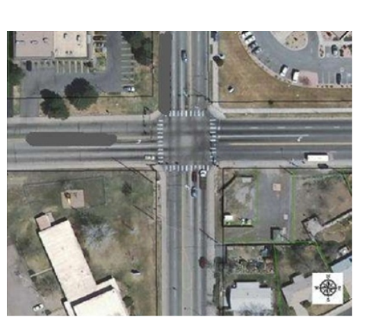
Examples In the Real world: #3
Look at the image. Tell me how many examples you can find of the terms you have been given?

Slide 13
Examples In the Real world: #4
Look at the image. Tell me how many examples you can find of the terms you have been given?

Slide 14
Using the Diagram Given, Give the Following

